Slide 1
Alice, Bob and Circuit

Slide 2
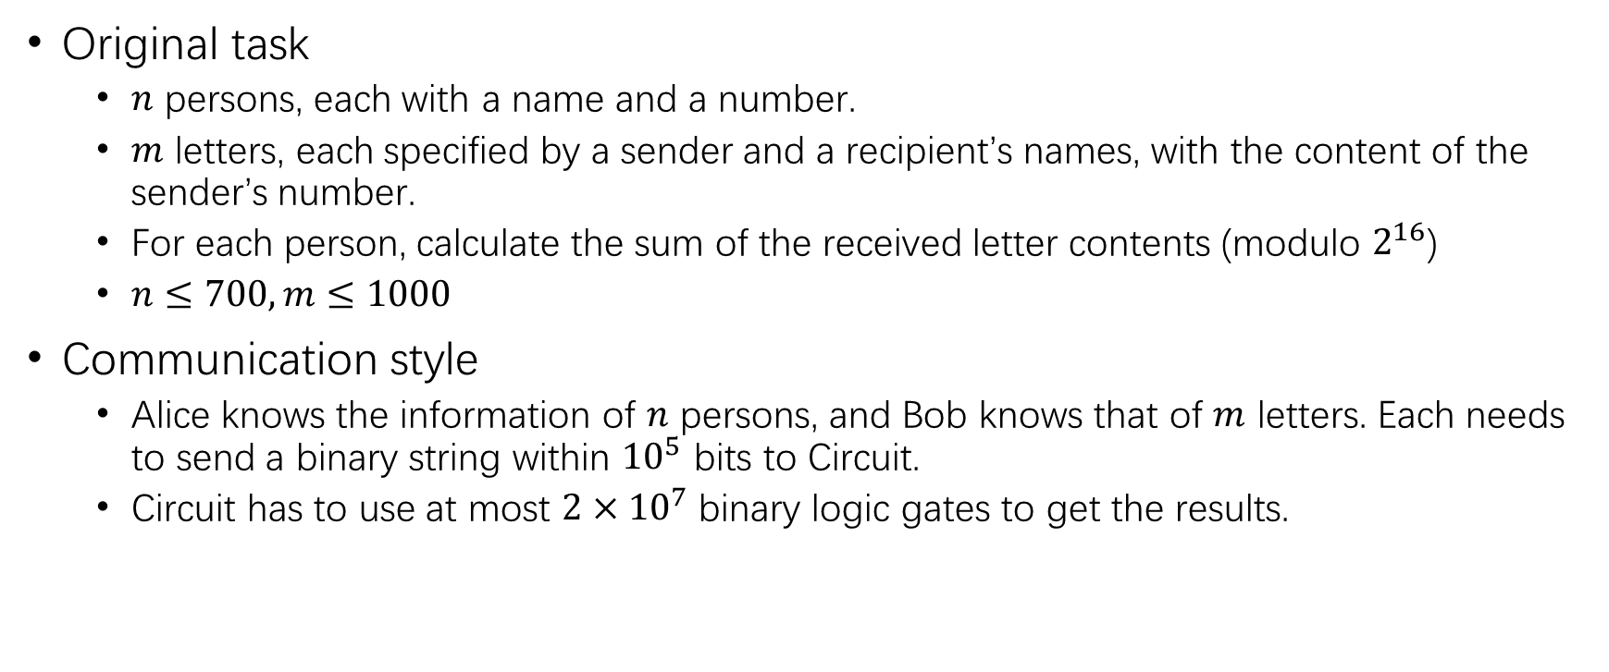
Task Review
Original task
$n$ persons, each with a name and a number.
$m$ letters, each specified by a sender and a recipient’s names, with the content of the sender’s number.
For each person, calculate the sum of the received letter contents (modulo $2^{16}$)
$n≤700,m≤1000$
Communication style
Alice knows the information of $n$ persons, and Bob knows that of $m$ letters. Each needs to send a binary string within ${10}^{5}$ bits to Circuit.
Circuit has to use at most $2×{10}^{7}$ binary logic gates to get the results.

Slide 3

Subtask 1
$n=1,m=0$
No letters are sent. The result is simply 0.
0 can be generated by a gate of operation=0.
Or, 0 can be sent from Alice to Circuit.
Expected score: 4 points.

Slide 4
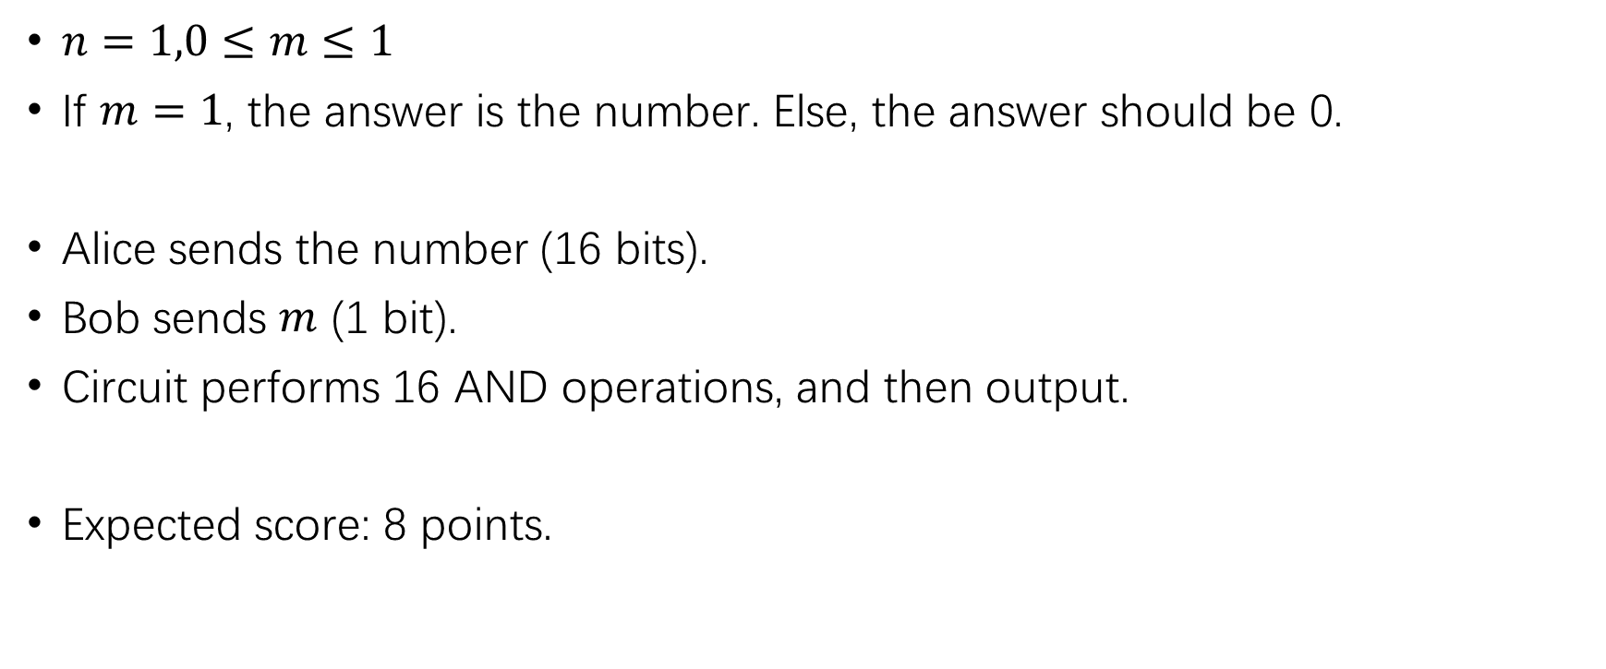
Subtask 2
$n=1,0≤m≤1$
If $m=1$, the answer is the number. Else, the answer should be 0.
Alice sends the number (16 bits).
Bob sends $m$ (1 bit).
Circuit performs 16 AND operations, and then output.
Expected score: 8 points.

Slide 5
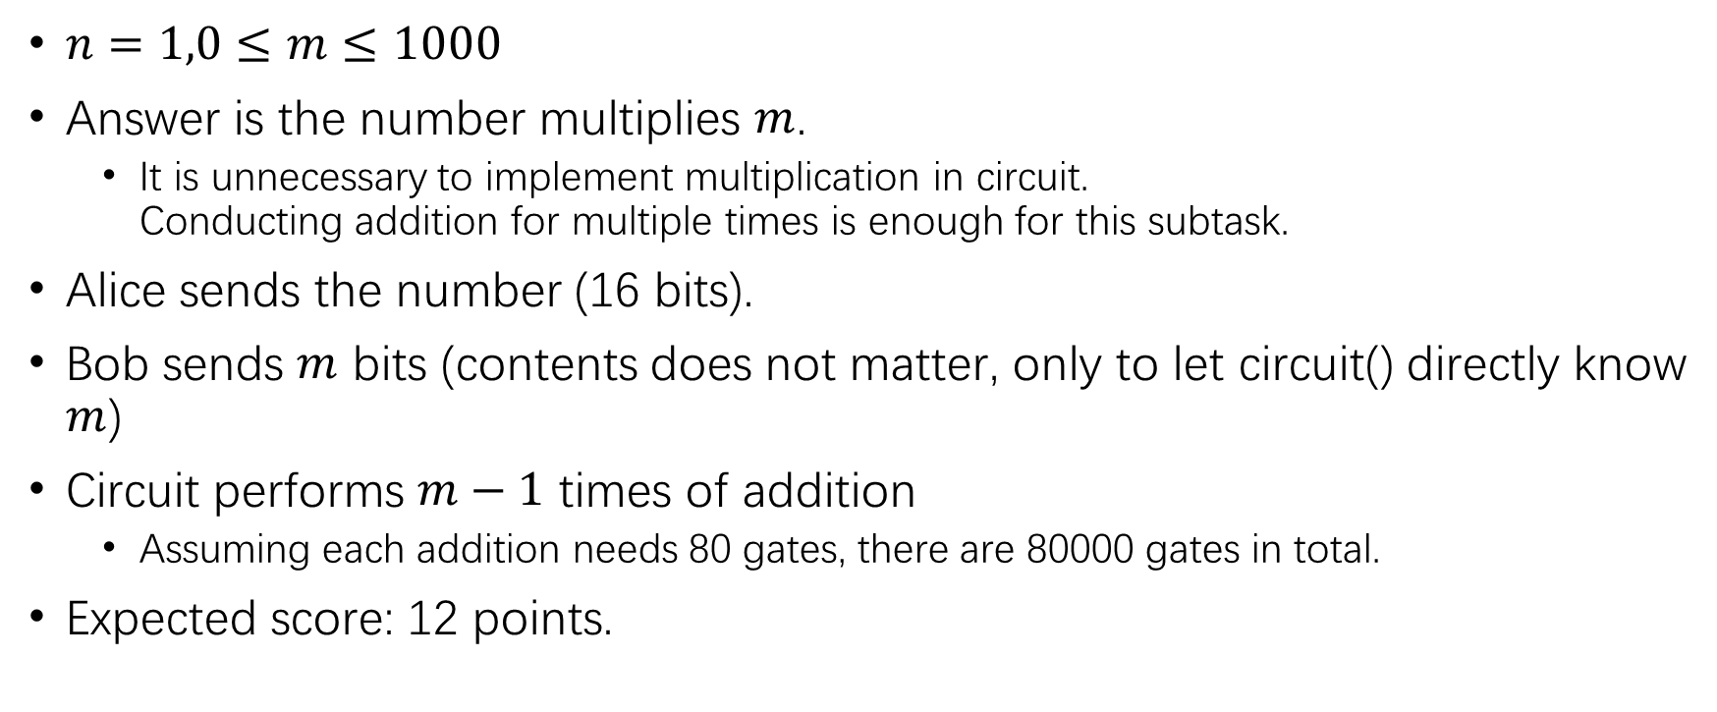
Subtask 3
$n=1,0≤m≤1000$
Answer is the number multiplies $m$.
It is unnecessary to implement multiplication in circuit. Conducting addition for multiple times is enough for this subtask.
Alice sends the number (16 bits).
Bob sends $m$ bits (contents does not matter, only to let circuit() directly know $m$)
Circuit performs $m−1$ times of addition
Assuming each addition needs 80 gates, there are 80000 gates in total.
Expected score: 12 points.

Slide 6
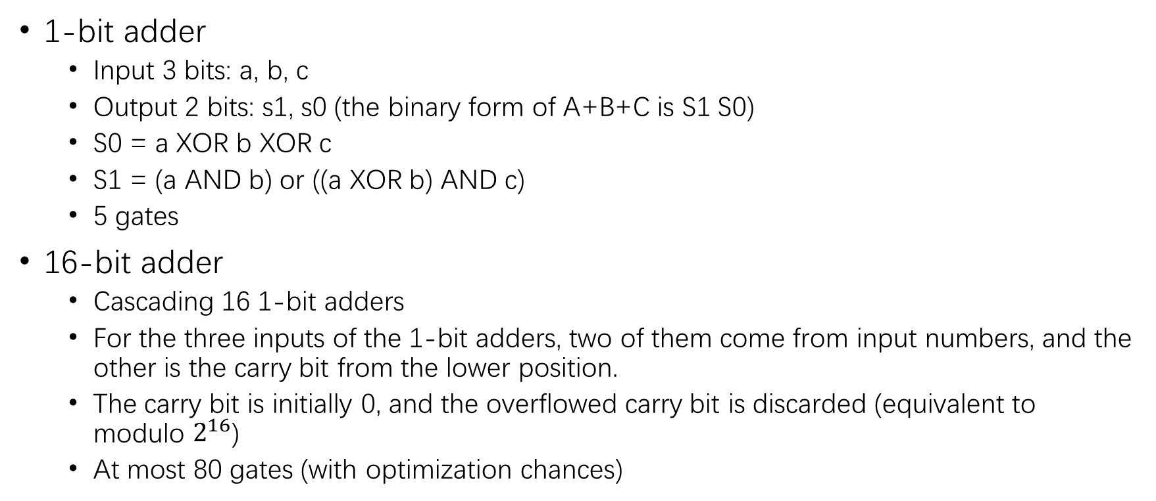
How to implement addition?
1-bit adder
Input 3 bits: a, b, c
Output 2 bits: s1, s0 (the binary form of A+B+C is S1 S0)
S0 = a XOR b XOR c
S1 = (a AND b) or ((a XOR b) AND c)
5 gates
16-bit adder
Cascading 16 1-bit adders
For the three inputs of the 1-bit adders, two of them come from input numbers, and the other is the carry bit from the lower position.
The carry bit is initially 0, and the overflowed carry bit is discarded (equivalent to modulo $2^{16}$)
At most 80 gates (with optimization chances)

Slide 7
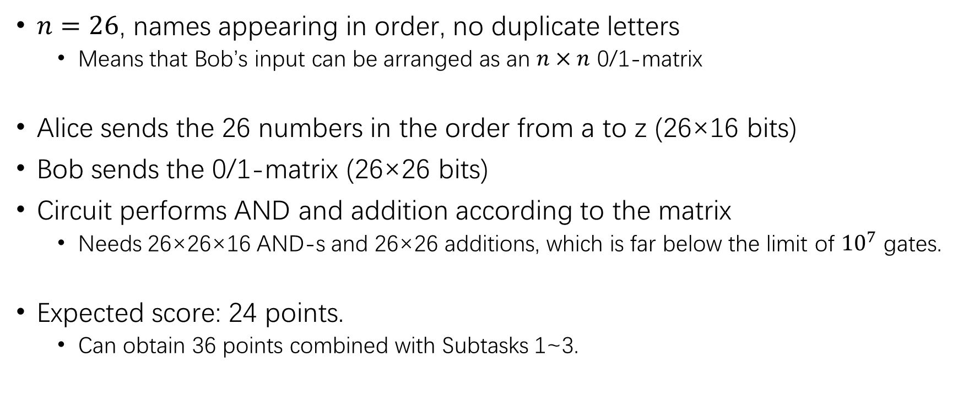
Subtask 4
$n=26$, names appearing in order, no duplicate letters
Means that Bob’s input can be arranged as an $n×n$ 0/1-matrix
Alice sends the 26 numbers in the order from a to z (26×16 bits)
Bob sends the 0/1-matrix (26×26 bits)
Circuit performs AND and addition according to the matrix
Needs 26×26×16 AND-s and 26×26 additions, which is far below the limit of ${10}^{7}$ gates.
Expected score: 24 points.
Can obtain 36 points combined with Subtasks 1~3.

Slide 8
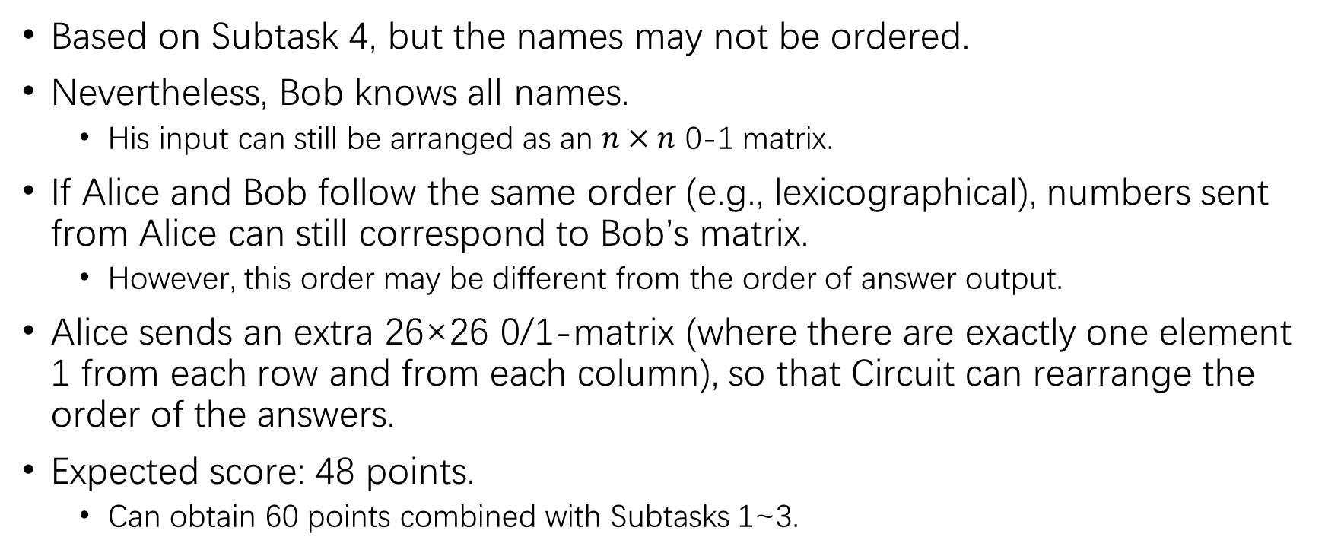
Subtask 5
Based on Subtask 4, but the names may not be ordered.
Nevertheless, Bob knows all names.
His input can still be arranged as an $n×n$ 0-1 matrix.
If Alice and Bob follow the same order (e.g., lexicographical), numbers sent from Alice can still correspond to Bob’s matrix.
However, this order may be different from the order of answer output.
Alice sends an extra 26×26 0/1-matrix (where there are exactly one element 1 from each row and from each column), so that Circuit can rearrange the order of the answers.
Expected score: 48 points.
Can obtain 60 points combined with Subtasks 1~3.

Slide 9
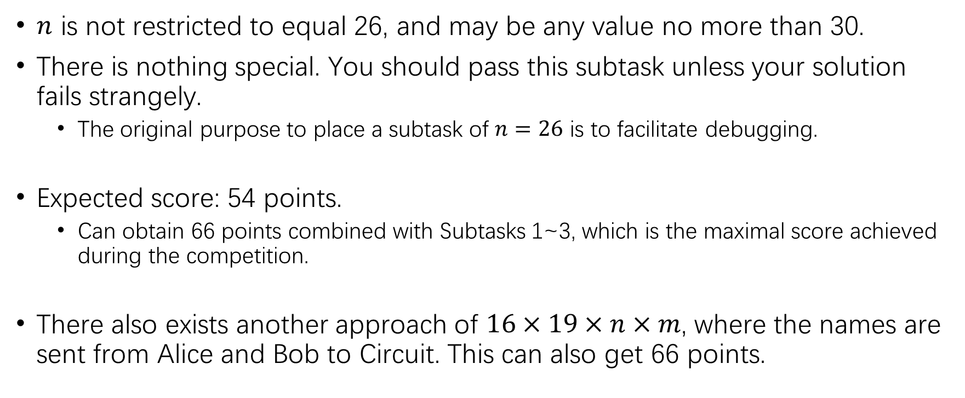
Subtask 6
$n$ is not restricted to equal 26, and may be any value no more than 30.
There is nothing special. You should pass this subtask unless your solution fails strangely.
The original purpose to place a subtask of $n=26$ is to facilitate debugging.
Expected score: 54 points.
Can obtain 66 points combined with Subtasks 1~3, which is the maximal score achieved during the competition.
There also exists another approach of $16×19×n×m$, where the names are sent from Alice and Bob to Circuit. This can also get 66 points.

Slide 10
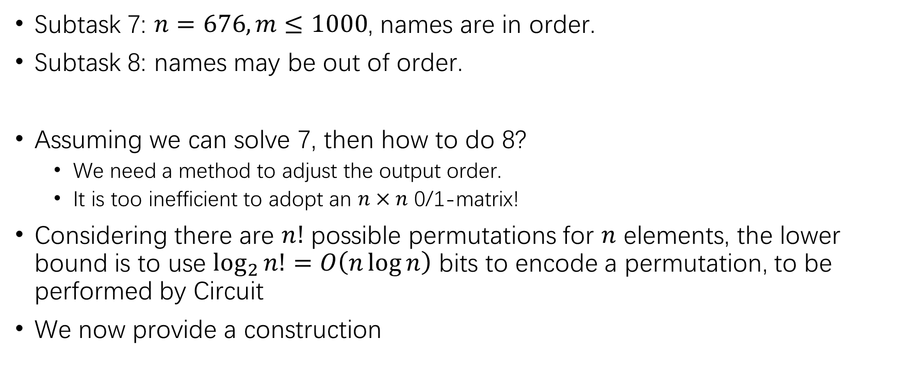
Subtasks 7~9
Subtask 7: $n=676,m≤1000$, names are in order.
Subtask 8: names may be out of order.
Assuming we can solve 7, then how to do 8?
We need a method to adjust the output order.
It is too inefficient to adopt an $n×n$ 0/1-matrix!
Considering there are $n!$ possible permutations for $n$ elements, the lower bound is to use $\log_{2}{n!}=O\left(n\log{n}\right)$ bits to encode a permutation, to be performed by Circuit
We now provide a construction

Slide 11

How to implement an $O\left(n\log{n}\right)$ permutation?
For example, we need to rearrange 20 elements to the ordered state.
Split the array into the upper and the lower halves, each with 10 elements.
Swap the elements up and down, so that every pair of numbers with difference 10 appears one upside and the other downside.
It can be proved that it is always possible to do so.
0 | 13 | 16 | 5 | 2 | 18 | 12 | 7 | 11 | 9
15 | 14 | 4 | 1 | 17 | 19 | 3 | 6 | 8 | 10
0 | 14 | 16 | 5 | 2 | 18 | 3 | 7 | 11 | 9
15 | 13 | 4 | 1 | 17 | 19 | 12 | 6 | 8 | 10
swap
swap
Every pair of numbers with difference 10 appears one upside and the other downside

Slide 12
How to implement an $O\left(n\log{n}\right)$ permutation?
Recursively process the upper half and the lower half, so that the ones-place becomes all correct.
Finally, swap the elements up and down, so that all elements become correct.
0 | 14 | 16 | 5 | 2 | 18 | 3 | 7 | 11 | 9
15 | 13 | 4 | 1 | 17 | 19 | 12 | 6 | 8 | 10
0 | 11 | 2 | 3 | 14 | 5 | 16 | 7 | 18 | 9
10 | 1 | 12 | 13 | 4 | 15 | 6 | 17 | 8 | 19
Every pair of numbers with difference 10 appears one upside and the other downside
0 | 11 | 2 | 3 | 14 | 5 | 16 | 7 | 18 | 9
10 | 1 | 12 | 13 | 4 | 15 | 6 | 17 | 8 | 19
0 | 1 | 2 | 3 | 4 | 5 | 6 | 7 | 8 | 9
10 | 11 | 12 | 13 | 14 | 15 | 16 | 17 | 18 | 19
swap
swap
swap
swap

Slide 13
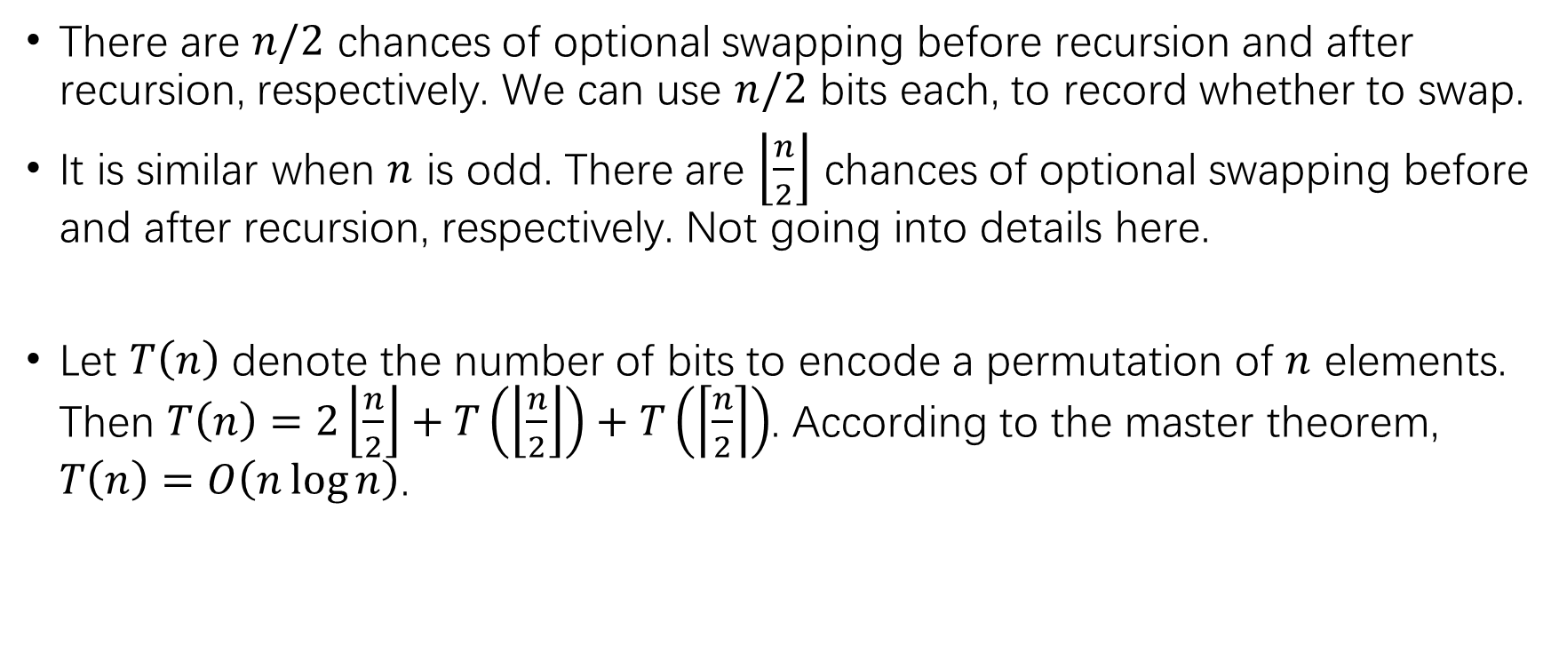
How to implement an $O\left(n\log{n}\right)$ permutation?
There are $n/2$ chances of optional swapping before recursion and after recursion, respectively. We can use $n/2$ bits each, to record whether to swap.
It is similar when $n$ is odd. There are $\left\lfloor \frac{n}{2}\right\rfloor$ chances of optional swapping before and after recursion, respectively. Not going into details here.
Let $T\left(n\right)$ denote the number of bits to encode a permutation of $n$ elements. Then $T\left(n\right)=2\left\lfloor \frac{n}{2}\right\rfloor +T\left(\left\lfloor \frac{n}{2}\right\rfloor \right)+T\left(\left\lceil \frac{n}{2}\right\rceil \right)$. According to the master theorem, $T\left(n\right)=O\left(n\log{n}\right)$.

Slide 14
Full-Score Algorithm
Convert each person and each letter to a 4-tuple (U, V, W, T).
A person with name X and number Y converts to (X, X, Y, 0).
A letter with sender P and receiver Q converts to (P, Q, 0, 1).
(Assuming each string is converted to a 19-bit integer.)
Sort all tuples by U first then V.
The sorting algorithm will be introduced later.
Consider all tuples in order, maintaining a temporary variable C:
When meeting an element of T=0 (person), assign: C <- (W of the current element)
When meeting an element of T=1 (letter), assign: (W of the current element) <- C
At this point, all letters are assigned with the sender’s number.

Slide 15
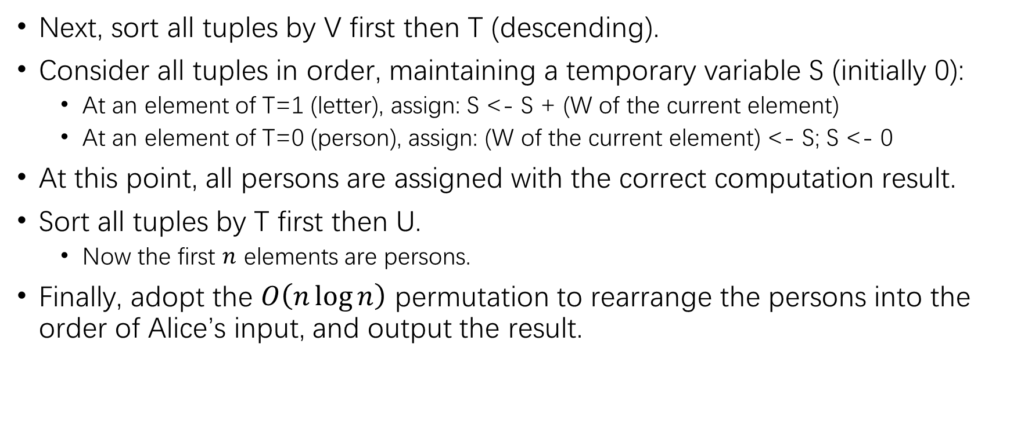
Full-Score Algorithm
Next, sort all tuples by V first then T (descending).
Consider all tuples in order, maintaining a temporary variable S (initially 0):
At an element of T=1 (letter), assign: S <- S + (W of the current element)
At an element of T=0 (person), assign: (W of the current element) <- S; S <- 0
At this point, all persons are assigned with the correct computation result.
Sort all tuples by T first then U.
Now the first $n$ elements are persons.
Finally, adopt the $O\left(n\log{n}\right)$ permutation to rearrange the persons into the order of Alice’s input, and output the result.

Slide 16
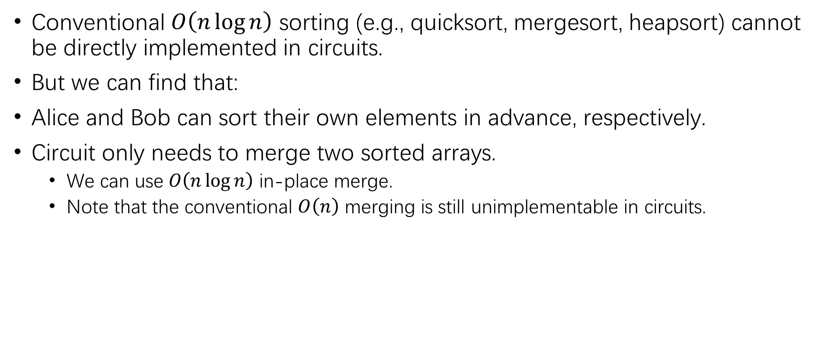
How to implement sorting?
Conventional $O\left(n\log{n}\right)$ sorting (e.g., quicksort, mergesort, heapsort) cannot be directly implemented in circuits.
But we can find that:
Alice and Bob can sort their own elements in advance, respectively.
Circuit only needs to merge two sorted arrays.
We can use $O\left(n\log{n}\right)$ in-place merge.
Note that the conventional $O\left(n\right)$ merging is still unimplementable in circuits.

Slide 17
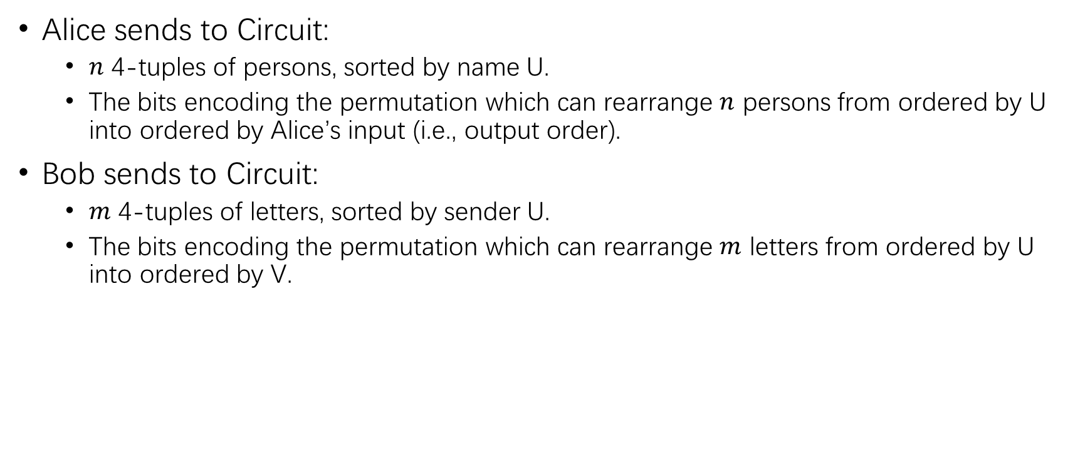
Final Algorithm
Alice sends to Circuit:
$n$ 4-tuples of persons, sorted by name U.
The bits encoding the permutation which can rearrange $n$ persons from ordered by U into ordered by Alice’s input (i.e., output order).
Bob sends to Circuit:
$m$ 4-tuples of letters, sorted by sender U.
The bits encoding the permutation which can rearrange $m$ letters from ordered by U into ordered by V.

Slide 18
Final Algorithm
Circuit’s computation:
After receiving the 4-tuples, merge two sorted arrays (first U then V).
Perform the first sequential scan, so that the letters are assigned with senders’ numbers.
Undo the previous merge (which can be implemented by recording whether each comparison leads to a swap).
Apply Bob’s permutation, to rearrange the letters from ordered by U into ordered by V.
Merge two sorted arrays again (first U then T descending).
Perform the second sequential scan, so that each person gets the correct result.
Undo the previous merge.
Apply Alice’s permutation, to rearrange the persons into Alice’s input order.
Output the answer.
Expected score: 100 points.

Slide 19
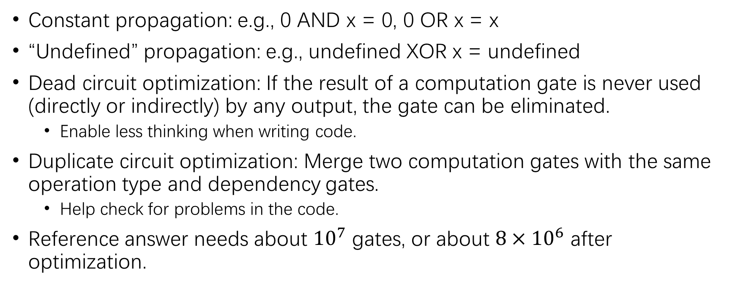
Possible but Unnecessary Optimizations
Constant propagation: e.g., 0 AND x = 0, 0 OR x = x
“Undefined” propagation: e.g., undefined XOR x = undefined
Dead circuit optimization: If the result of a computation gate is never used (directly or indirectly) by any output, the gate can be eliminated.
Enable less thinking when writing code.
Duplicate circuit optimization: Merge two computation gates with the same operation type and dependency gates.
Help check for problems in the code.
Reference answer needs about ${10}^{7}$ gates, or about $8×{10}^{6}$ after optimization.

Slide 20
The End

